Slide 1
Breweries & Beers Data Analysis
By: Solange Garcia de Alford
October 18, 2019

Slide 2
Breweries & Beers – Data Analysis
Executive Summary
The data analysis is based on data provided by our data sourcing contracting company. The data provided a number of independent breweries located in the United States accompanied by a list of their beer brands.
This analysis provides answers to questions of interest submitted with the analysis request, such as:
Where the breweries are located
Where do we find the highest median in alcohol content
Where do we find the highest median International Bitterness Units
Important statistics
We assigned some of the finest data scientists to this project to explore and report on these data. We understand these answers are pivotal in your future business and marketing decisions.

Slide 3
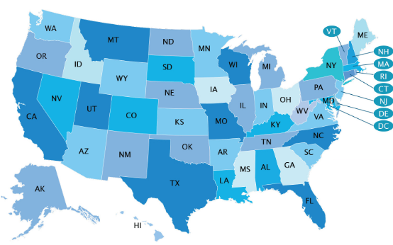
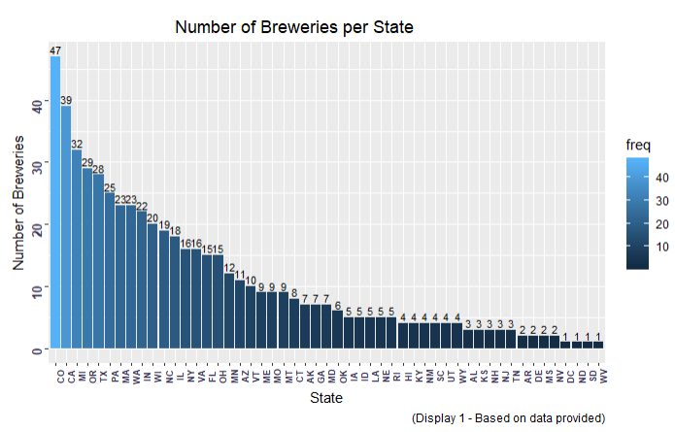
Breweries & Beers – Data Analysis
Breweries Located in each State
Colorado 47
California
Michigan
Oregon
Texas

Slide 4
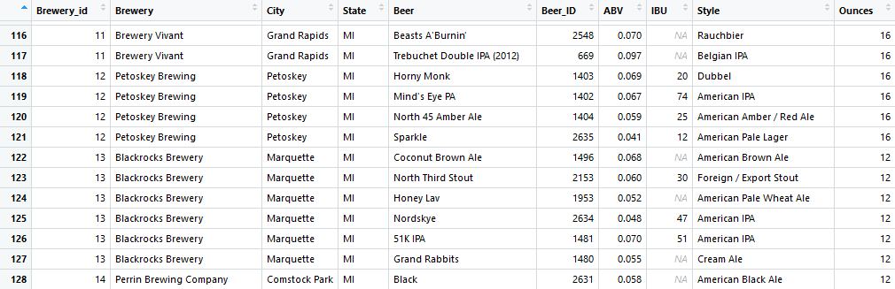
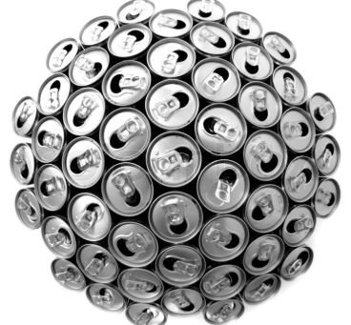
Breweries & Beers – Data Analysis
Breweries (558) and Beers (2,410) Data
2,410 Brands
2.60 % had an unknown ABV value
42% had an unknown IBU value

Slide 5
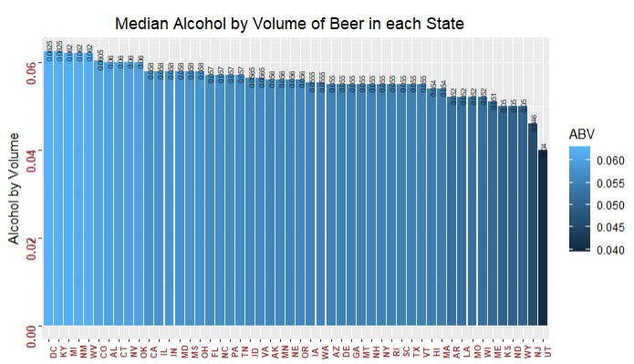
Breweries & Beers – Data Analysis
Highest Median Alcohol by Beer Volume (ABV) 0.0625
Kentucky
Washington, DC
Michigan
New Mexico
West Virginia
Colorado
Alabama
Connecticut
Nevada
Oklahoma
ABV Variable Summary Statistics across All States
ABV median 0.056
ABV mean 0.05977
ABV lowest and highest values were 0.001 and 0.128

Slide 6
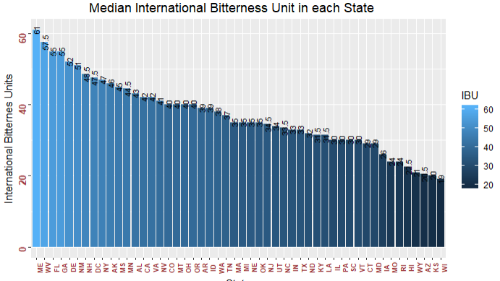
Breweries & Beers – Data Analysis
Highest Median International Bitterness Unit (IBU)
Maine - 61 IBU
West Virginia
Florida
Georgia
Delaware
New Mexico
New Hampshire
Washington DC
New York
Alaska

Slide 7
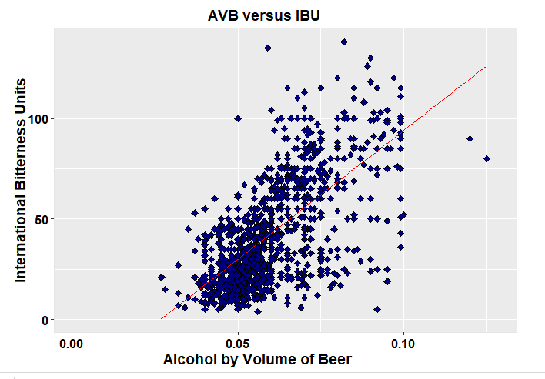
Breweries & Beers – Data Analysis
Relationship between Alcohol Content by Volume of Beer
and
International Bitterness Units
ABV
(Highest Medians)
Washington, DC
Kentucky
Michigan
New Mexico
West Virginia
Colorado
Alabama
Connecticut
Nevada
Oklahoma
IBU
(Highest Medians)
Maine
West Virginia - 1
Florida
Georgia
Delaware
New Mexico - 3
New Hampshire
Washington DC - 1
New York
Alaska

Slide 8
Breweries & Beers – Data Analysis
Conclusion
Data
Breweries by state
Colorado with 47 Breweries
ABV lowest and highest values were 0.001 and 0.128
Highest ABV and IBU Medians by State
ABV - Kentucky and DC’s at 0.0625
IBU - Maine at 61
Correlations between ABV and IBU values
Thank you for the trust you placed in our company!

